Slide 1


<Name>
<Date>

Slide 2

Outline
Executive Summary
Introduction
Methodology
Results
Conclusion
Appendix

Slide 3
Executive Summary
Summary of methodologies
Summary of all results

Slide 4
Introduction
Project background and context
Problems you want to find answers

Slide 5

Section 1

Slide 6
Methodology
Executive Summary
Data collection methodology:
The data was collected with SpaceX API and Web Scraping
Perform data wrangling
The data was processed with the Pandas library.
Perform exploratory data analysis (EDA) using visualization and SQL
Perform interactive visual analytics using Folium and Plotly Dash
Perform predictive analysis using classification models
How to build, tune, evaluate classification models

Slide 7
Data Collection
The data was collected by using the official SpaceX API
In the data collection I also used the SpaceX Wikipedia page, web scraped it to get more information.

Slide 8
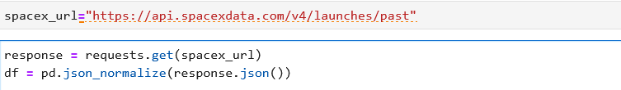
Data Collection – SpaceX API
I used the Request library to get information from the SpaceX API, and then turned it into a JSON format then a Data Frame
https://github.com/MagyarEper/DataScienceCapstoneProject/blob/main/Data%20collection%2C%20processing/jupyter-labs-spacex-data-collection-api.ipynb

Slide 9
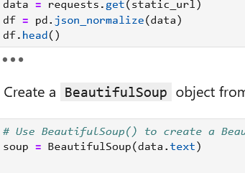
Data Collection - Scraping
I used Beautiful Soup Library to scrape the data from the Wikipedia page, then transformed and analyzed it
https://github.com/MagyarEper/DataScienceCapstoneProject/blob/main/Data%20collection%2C%20processing/jupyter-labs-webscraping.ipynb

Slide 10
Data Wrangling
I Processed the gathered data by looking at different statistics and data points.
https://github.com/MagyarEper/DataScienceCapstoneProject/blob/main/Data%20collection%2C%20processing/labs-jupyter-spacex-Data%20wrangling.ipynb

Slide 11
EDA with Data Visualization
For the EDA with Data Vizualization part I used many different type of charts and plots to analyze the data.
https://github.com/MagyarEper/DataScienceCapstoneProject/blob/main/EDA/edadataviz.ipynb

Slide 12
EDA with SQL
By using different SQL queries I explored the data further to get more insight.
https://github.com/MagyarEper/DataScienceCapstoneProject/blob/main/EDA/jupyter-labs-eda-sql-coursera_sqllite.ipynb

Slide 13
Build an Interactive Map with Folium
With folium, I visualized the launch sites and the successful/unsuccessful launches on a map.
https://github.com/MagyarEper/DataScienceCapstoneProject/blob/main/Visual%20analytics/lab_jupyter_launch_site_location.ipynb

Slide 14
Build a Dashboard with Plotly Dash
Summarize what plots/graphs and interactions you have added to a dashboard
Explain why you added those plots and interactions
Add the GitHub URL of your completed Plotly Dash lab, as an external reference and peer-review purpose

Slide 15
Predictive Analysis (Classification)
In this section I tried different machine learning models to accurately make predictions about the dataset.
https://github.com/MagyarEper/DataScienceCapstoneProject/blob/main/ML/SpaceX_Machine%20Learning%20Prediction_Part_5.ipynb

Slide 16
Results
Exploratory data analysis results
Interactive analytics demo in screenshots
Predictive analysis results

Slide 17

Section 2

Slide 18
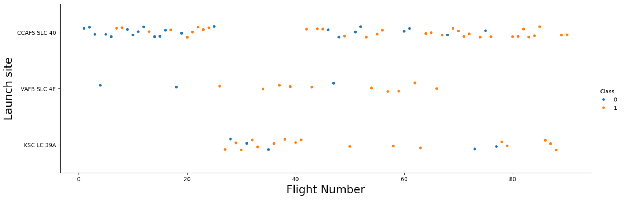
Flight Number vs. Launch Site

Slide 19
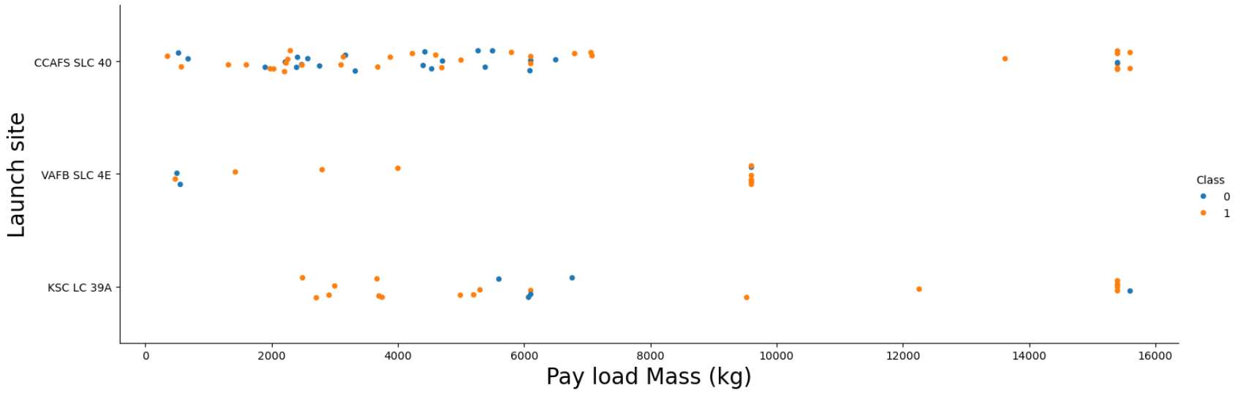
Payload vs. Launch Site

Slide 20
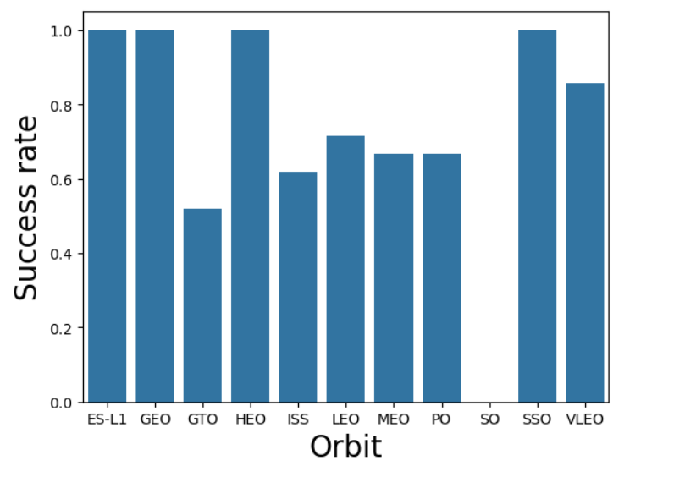
Success Rate vs. Orbit Type

Slide 21
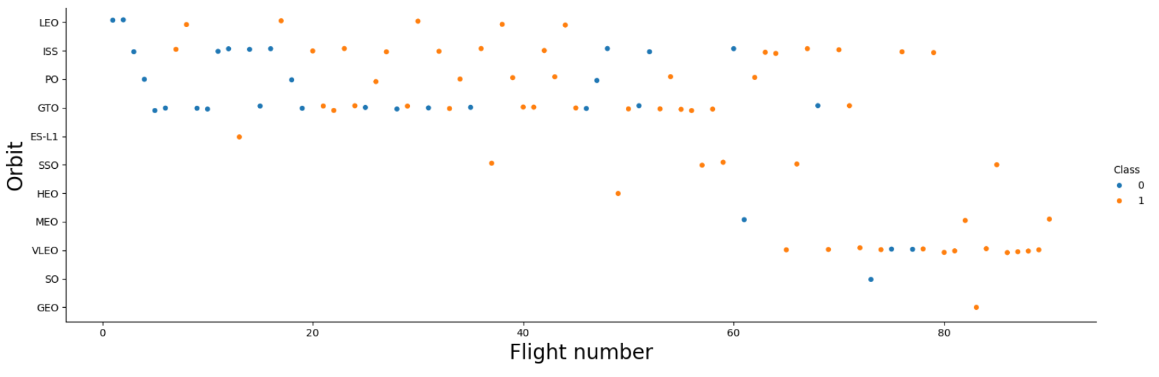
Flight Number vs. Orbit Type

Slide 22
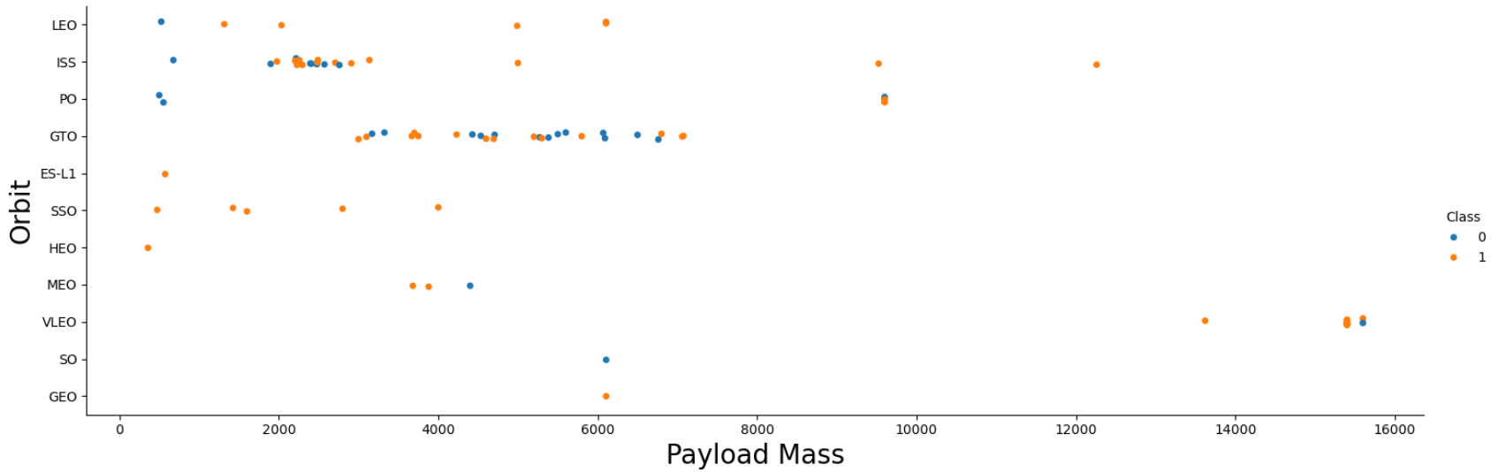
Payload vs. Orbit Type

Slide 23
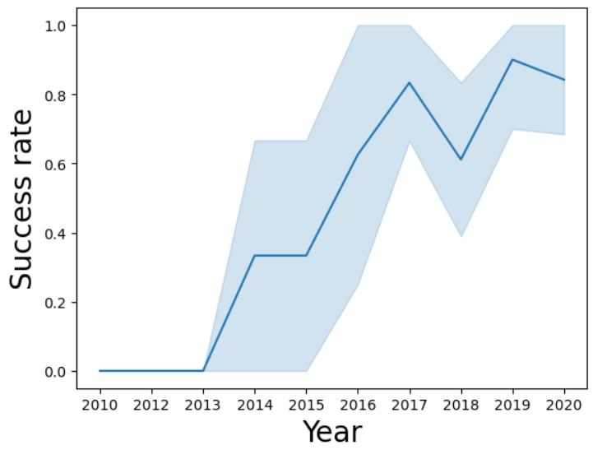
Launch Success Yearly Trend

Slide 24
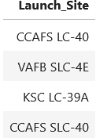
All Launch Site Names
There are four unique Launch sites in the dataset.

Slide 25
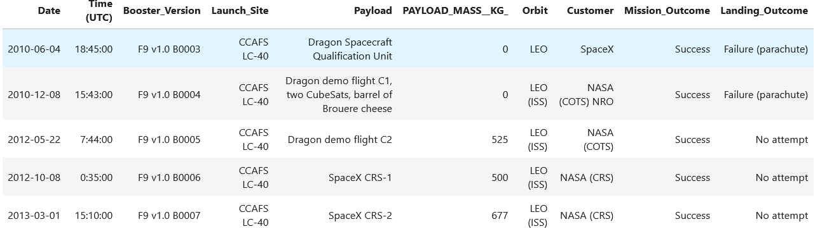
Launch Site Names Begin with 'CCA'
The top five result where the launch site begins with CCA

Slide 26
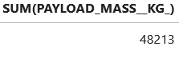
Total Payload Mass
The total payload carried by boosters from NASA was 48.213 KG

Slide 27
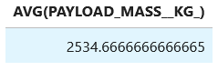
Average Payload Mass by F9 v1.1
The average payload mass carried by booster version F9 v1.1

Slide 28
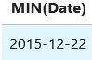
First Successful Ground Landing Date
The date of the first successful landing outcome on ground pad was 2015.12.22.

Slide 29
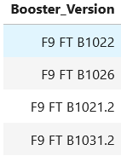
Successful Drone Ship Landing with Payload between 4000 and 6000
Names of boosters which have successfully landed on drone ship and had payload mass greater than 4000 but less than 6000

Slide 30
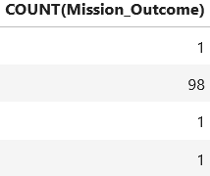
Total Number of Successful and Failure Mission Outcomes
The total number of successful and failure mission outcomes

Slide 31
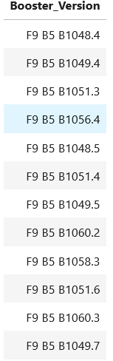
Boosters Carried Maximum Payload
Names of the booster which have carried the maximum payload mass

Slide 32
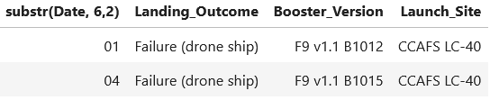
2015 Launch Records
The failed landing_outcomes in drone ship, their booster versions, and launch site names for in year 2015

Slide 33
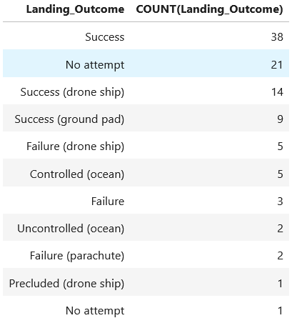
Rank Landing Outcomes Between 2010-06-04 and 2017-03-20
Count of landing outcomes (such as Failure (drone ship) or Success (ground pad)) between the date 2010-06-04 and 2017-03-20, in descending order.

Slide 34

Section 3

Slide 35
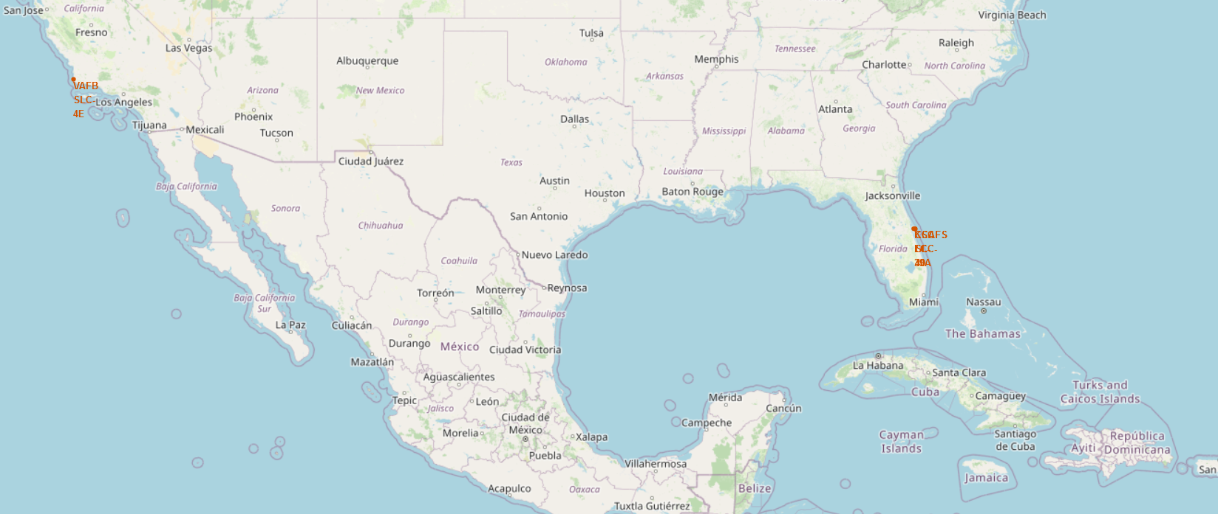
<Launch site locations>

Slide 36
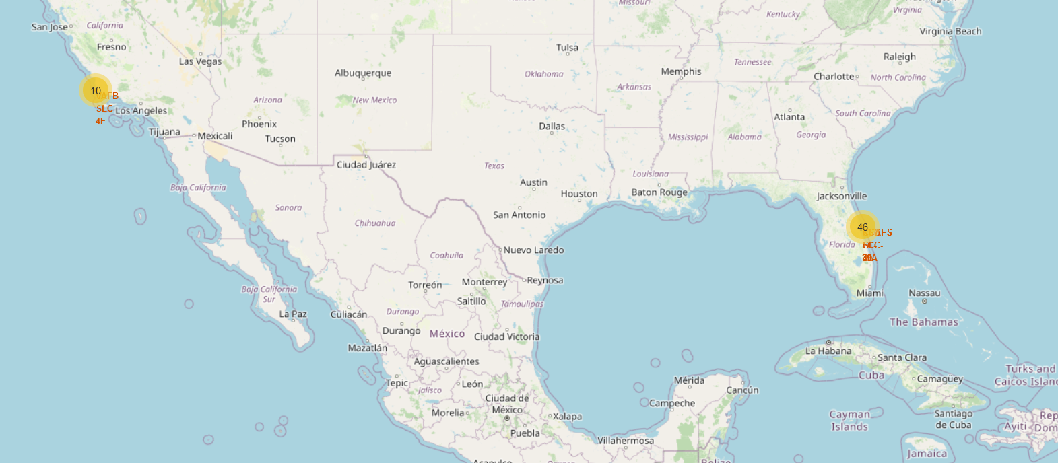
<Location of successful/unsuccessful launches>

Slide 37
<Distance between launch site proximities>

Slide 38

Section 4

Slide 39
<Dashboard Screenshot 1>
Replace <Dashboard screenshot 1> title with an appropriate title
Show the screenshot of launch success count for all sites, in a piechart
Explain the important elements and findings on the screenshot

Slide 40
<Dashboard Screenshot 2>
Replace <Dashboard screenshot 2> title with an appropriate title
Show the screenshot of the piechart for the launch site with highest launch success ratio
Explain the important elements and findings on the screenshot

Slide 41
<Dashboard Screenshot 3>
Replace <Dashboard screenshot 3> title with an appropriate title
Show screenshots of Payload vs. Launch Outcome scatter plot for all sites, with different payload selected in the range slider
Explain the important elements and findings on the screenshot, such as which payload range or booster version have the largest success rate, etc.

Slide 42
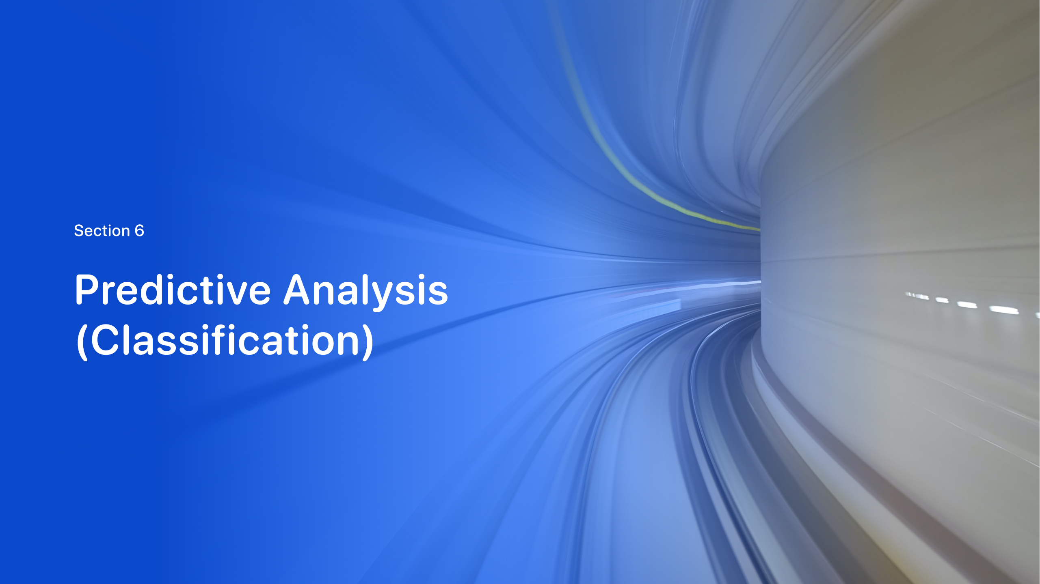
Section 5

Slide 43
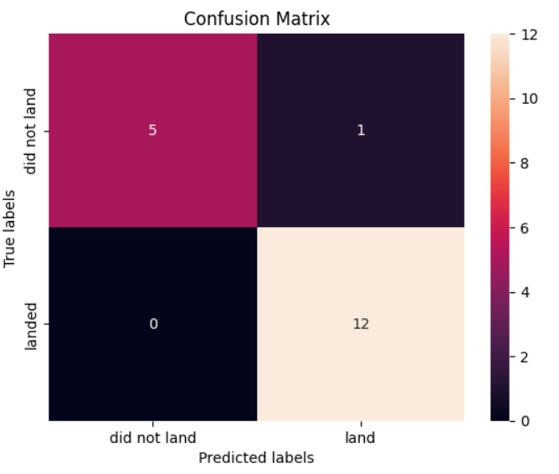
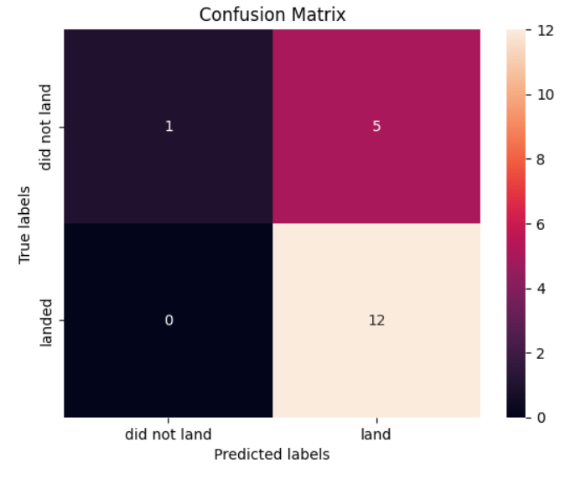
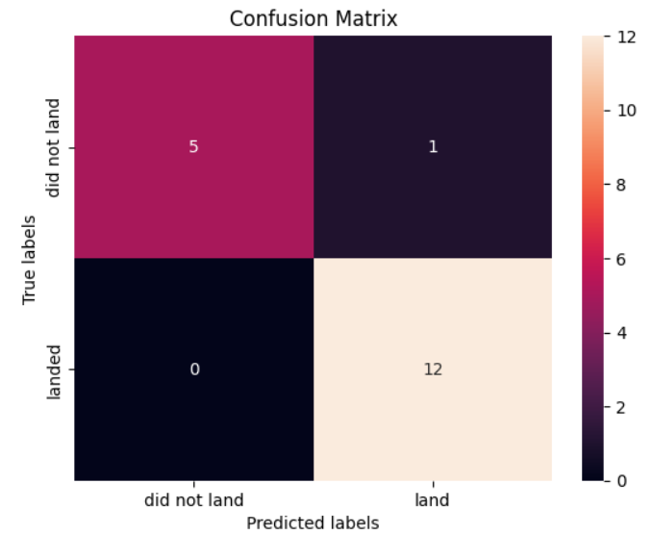
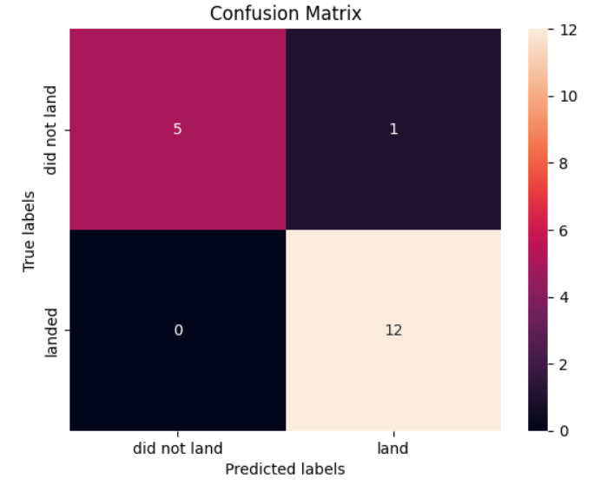
Classification Accuracy
Logistic regression:
Accuracy: 0.82222
Decision tree:
Accuracy: 0.9222
Support Vector Machine:
Accuracy: 0.82222
K Nearest Neighbor:
Accuracy: 0.84444

Slide 44
Confusion Matrix

Slide 45
Conclusions
Point 1
Point 2
Point 3
Point 4
…

Slide 46
Appendix
Include any relevant assets like Python code snippets, SQL queries, charts, Notebook outputs, or data sets that you may have created during this project

Slide 47


